Slide 1
China's cheap Xiaomis are low on privacy
github: huuck twitter: @hookgab
Notes:
fellow humans
or how the product sells you but first, a small introduction

Slide 2
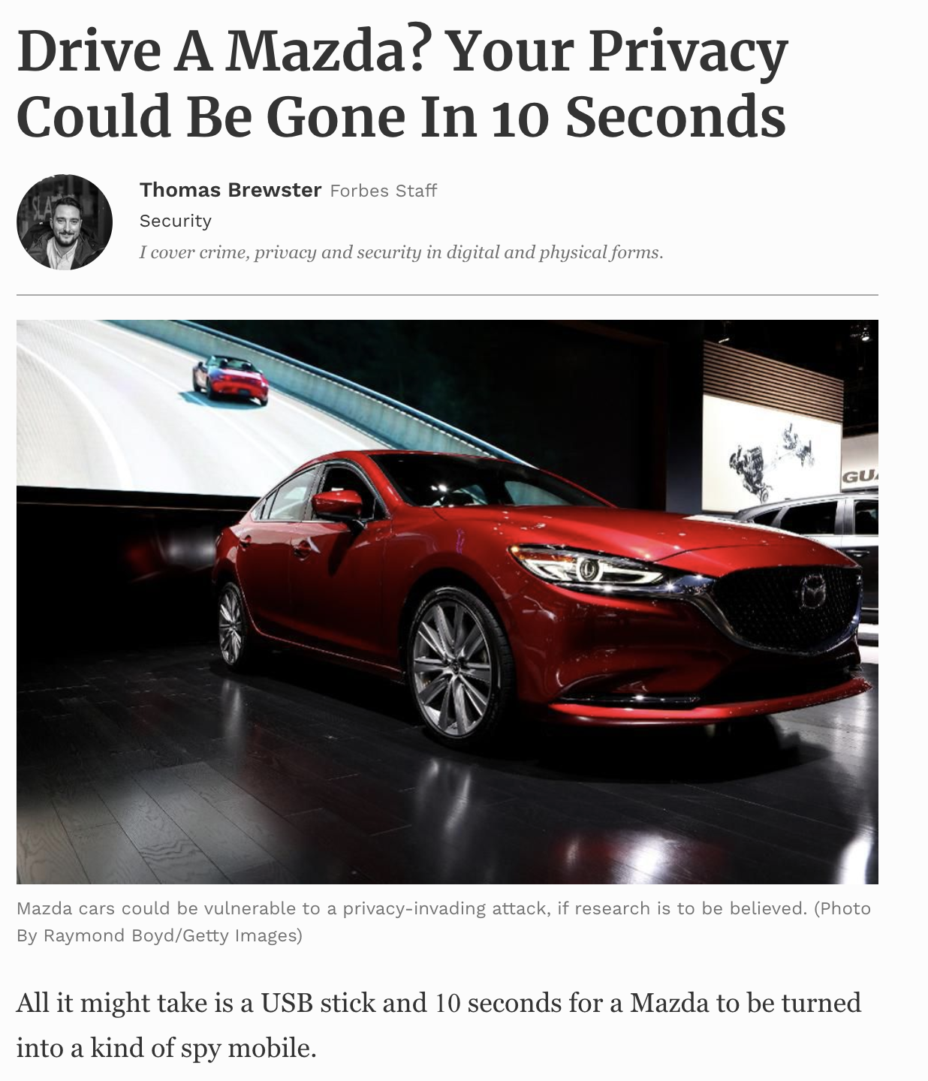

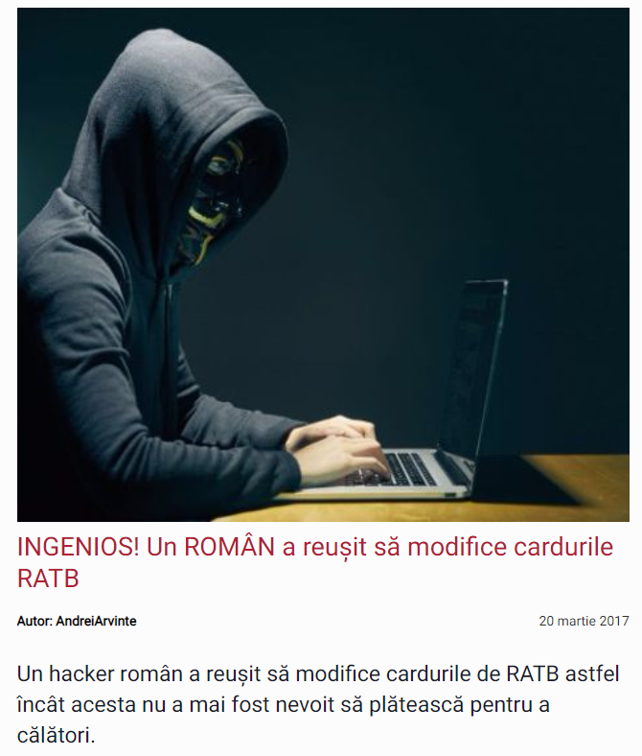
whoami
INGENIOUS! A ROMANIAN managed
to modify public transportation cards!
Notes:
I'm gabi and I'm pretty fresh in the industry started by hacking the public transit system in romania.
when I discovered that my free fares are up I turned eyes on my car and out it knew about me way more than I knew about myself.
long story short, it logged everything I was doing, just like the actor were' gonna talk about today
recently I turned to hunting bots for whiteops, but I still keep my eye on any privacy infringing companies.
So I decided get a Xiaomi phone, and why, you might ask me?

Slide 3
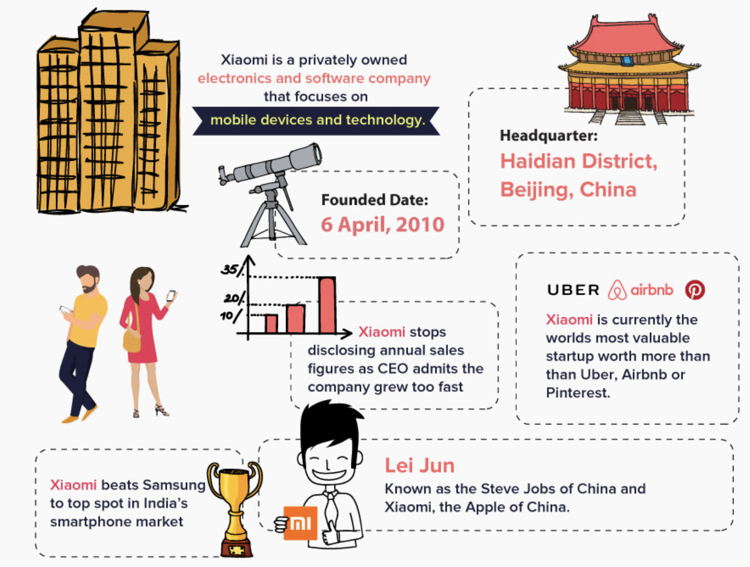
./who
Notes:
they are the 4th biggest phone producers in the world

Slide 4
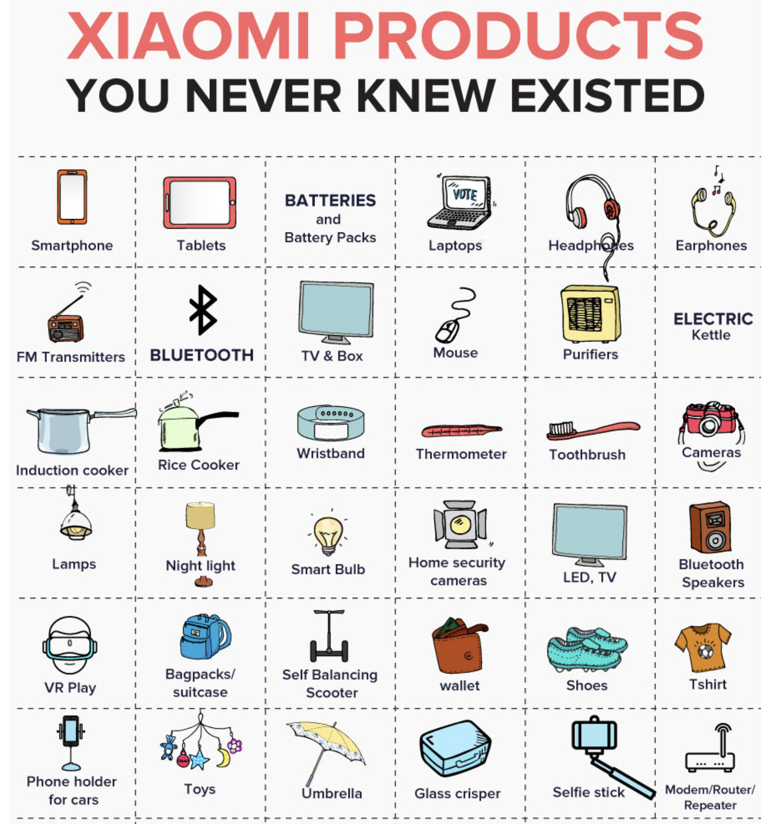
./who
Notes:
you can live your entire life in xiaomi products

Slide 5
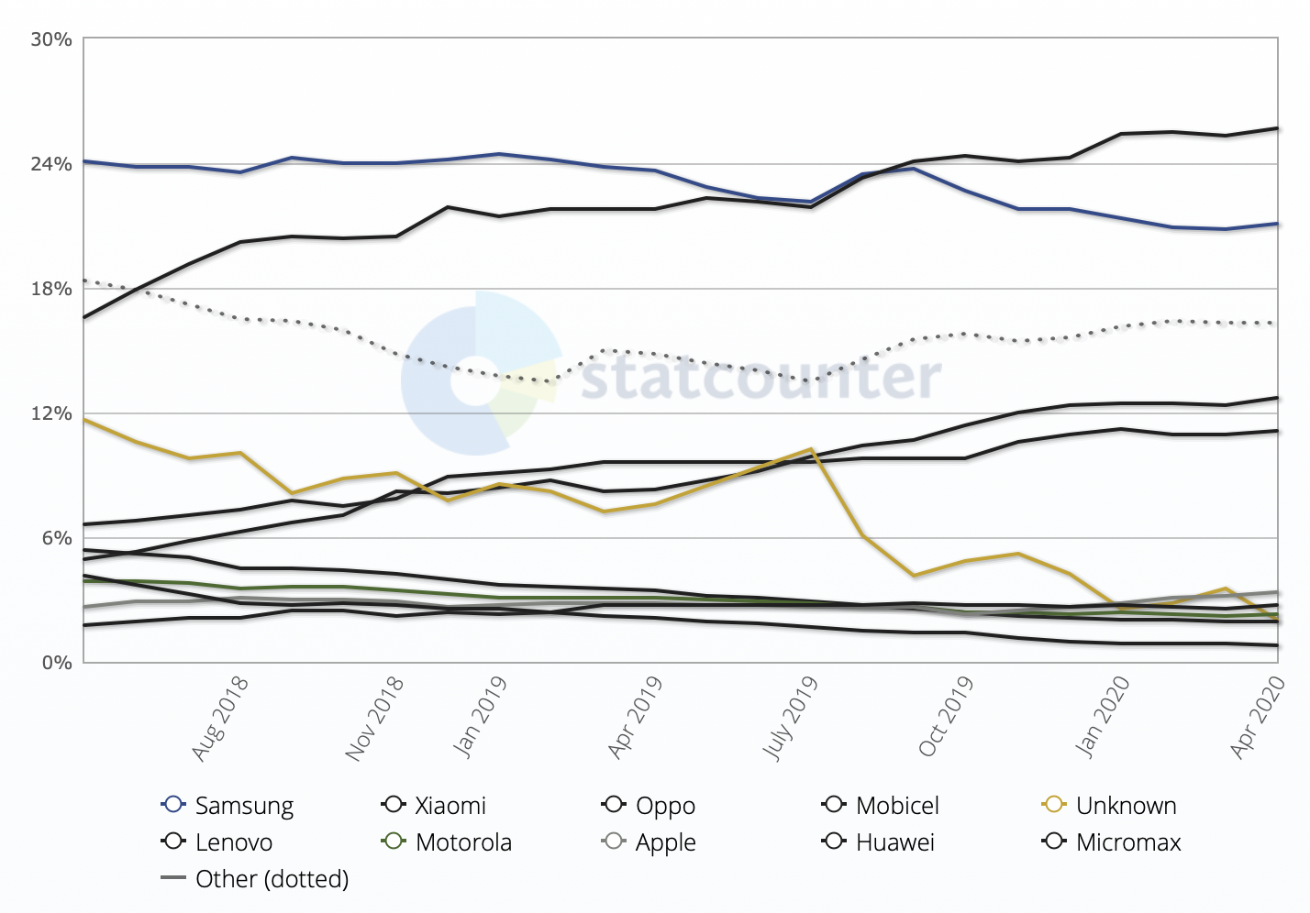
./who
Notes:
and the biggest in India

Slide 6
./why
cheap
powerful
decent camera
NFC
solid display
???
what's the catch?
Notes:
redmi note 8
snapdragon 660
4/6GB ram
large battery
everything for a daily driver

Slide 7
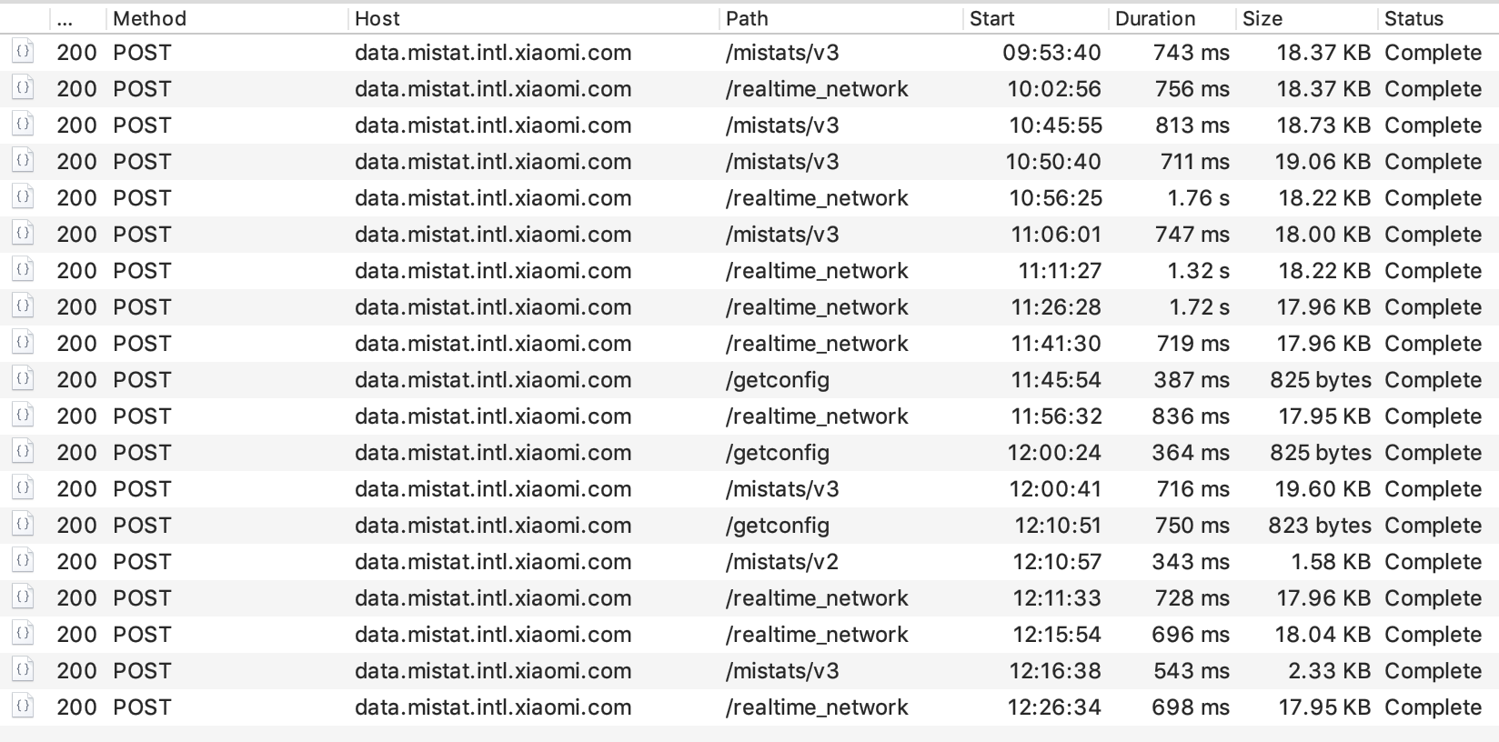
./how
brand new phone
rooted + custom cert
...
oh my that's a load of data
Notes:
after android 7 (including) you can no longer intercept SSL traffic using user certificates. This requires you to root the phone and put your own certificate inside the system partition.
take a good look at this panel. I've only decrypted 20% of this data!!!

Slide 8
Notes:
this is spyware in a box.
they are keen on sucking up ALL the data that you "consent" to share.
and just to prove it, we're gonna watch a little demo I recorded.

Slide 9


Slide 10

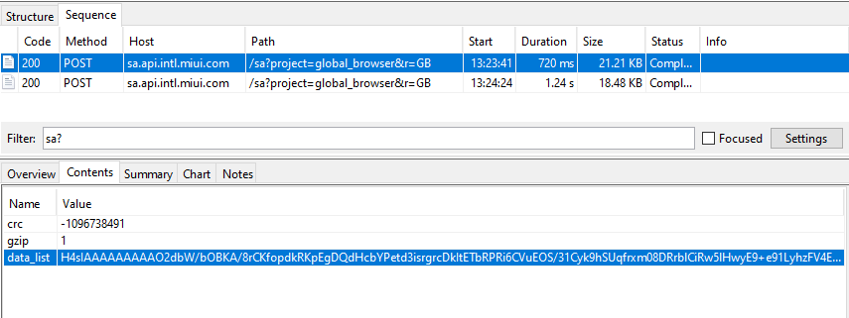
./how
Notes:
so this is how it happens:
we navigate to a site...

Slide 11
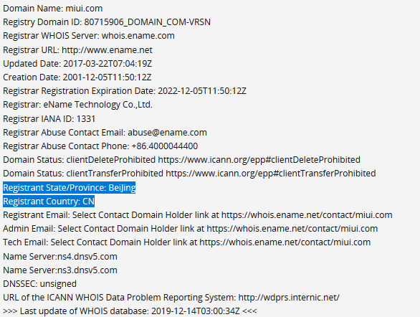
./how
Notes:
domain points to an IP in Alibaba's cloud infrastructure

Slide 12
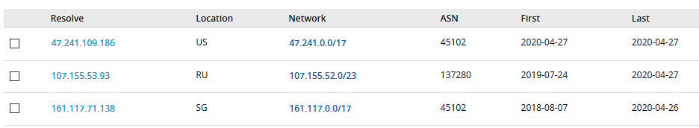
./how
Notes:
based on our location, the data ends somewhere at these IPs

Slide 13
./recap.sh
new phone
no apps
24 calls in 3 hours
chinese infrastructure
wat.jpg

Slide 14
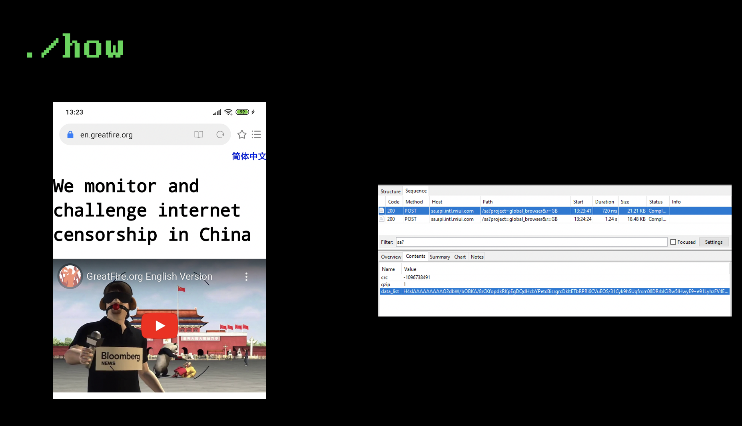
./what
slideception.jpg
Notes:
Now if you recall this slide, let's dive a bit more into it

Slide 15
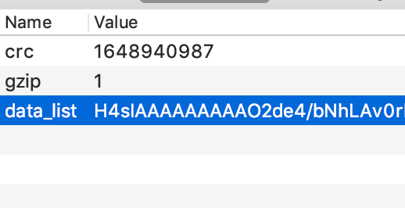
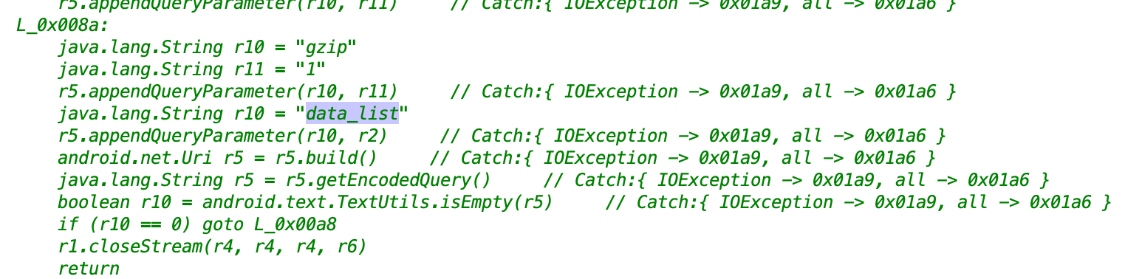
./how
sendHTTPRequest()
Notes:
don't forget the sendHTTPRequest function

Slide 16
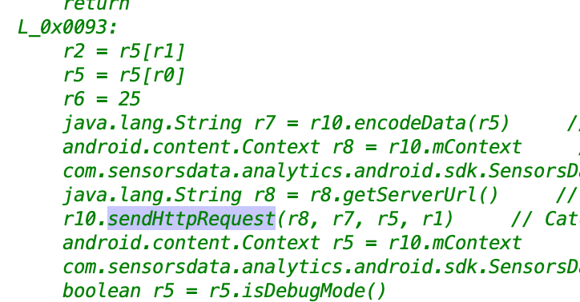
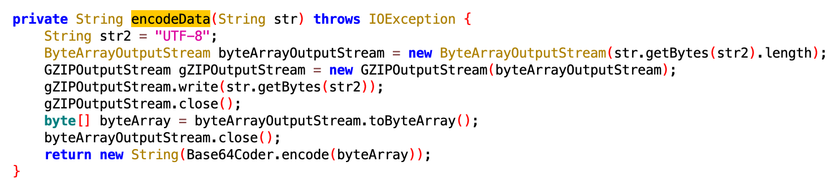
./how
Notes:
point to encodeData

Slide 17
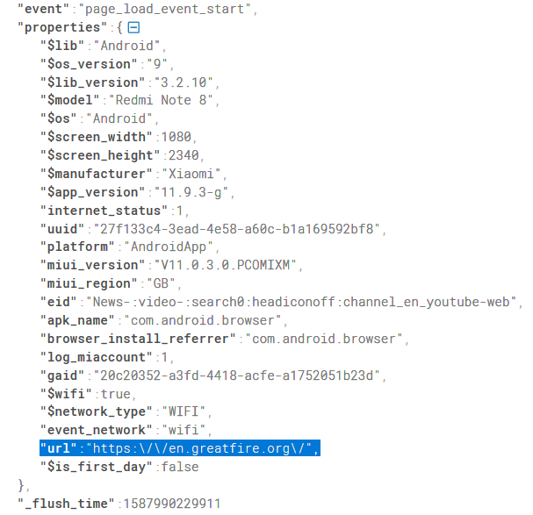
./what
visited URL
network type
device info
UUID (more later)
but wait, there's more

Slide 18
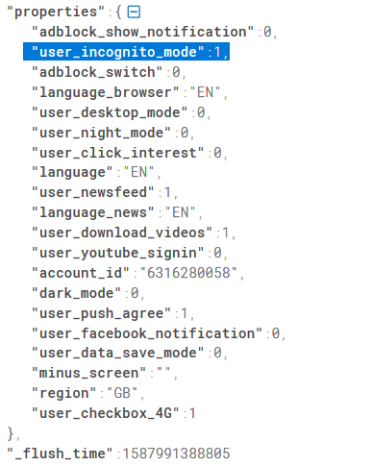
./what
MIUI id!!!
...
INCOGNITO MODE
Notes:
and this is not the only place where the MIUI id is being usd

Slide 19
./what
MIUI id
UUID ('member it?)
you cannot create a MIUI id without your phone number/email/social media account
Notes:
it's also in the headers
and this is tied (the UUID) with ALL the systemwide logs

Slide 20
./recap.sh
visited URLs
browsing history
search engine history
browsing behaviour
all can be correlated to your real persona
happens even in incognito mode

Slide 21
but wait, there's more

Slide 22
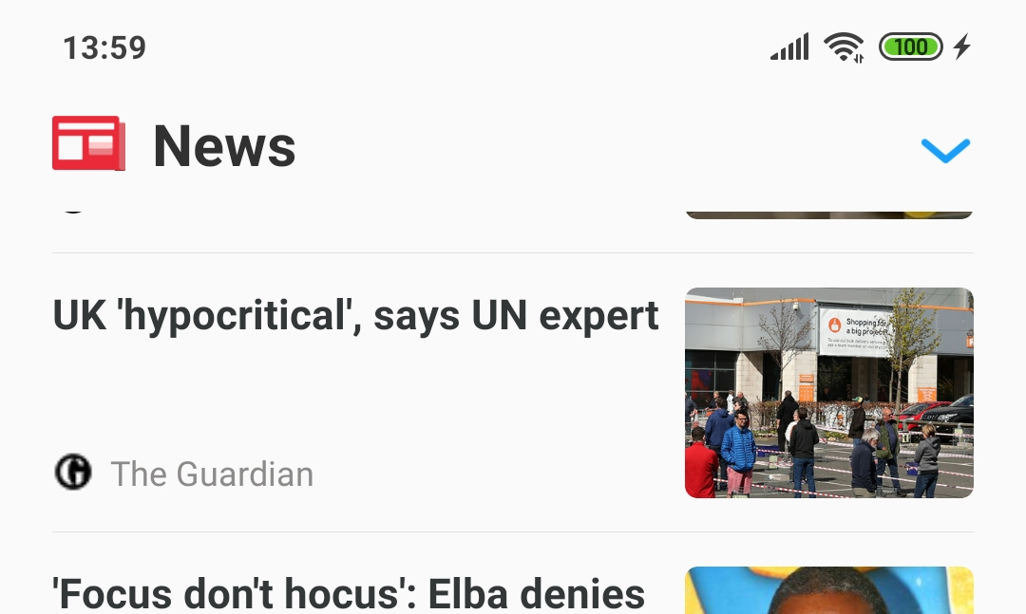
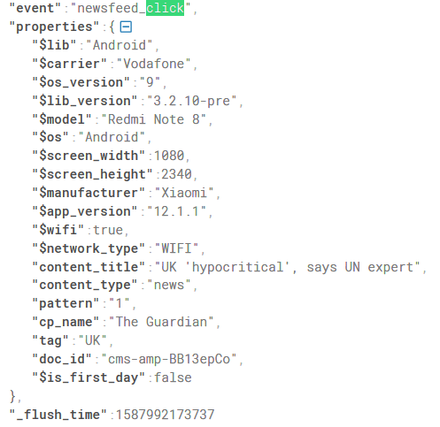
./what
Notes:
it's not only you that view the news, it's also comrade officer

Slide 23
./what
Notes:
now let's listen to some sick tunes. OFFLINE.

Slide 24
./what
Notes:
komrade officer knows

Slide 25
./recap.sh
what news you watch
what music you play OFFLINE
what are your home screen folders named
Notes:
I promise this is the last one
----
Remember some of the initial slides with the 20% tarffic decripted? That's how I found about the last one. It uses AES encrytion with a proper IV. The key is stored inside Android's key store somewhere and differs from app to app session. They REALLY put a lot of effort into that traffic, and I've only been able to sniff just a couple of the keys.

Slide 26

./what
download firmware
brotli extractor
sdat2img
pull APKs/VDEX from system.img
???
prophit
Notes:
and this doesn't only happen on my phone. I've pulled the firmware from their official site for Xiaomi MI 10, Xiaomi Redmi K20 and Xiaomi Mi MIX 3 devices and found the exact same code that's responsible for exfiltrating data in all of them. It even looks like it's a MIUI "feature". Yeah, that's right, that custom rom that everybody loves on XDA.

Slide 27
./aftermath
Notes:
what did they do?
they denied it vehemently initially, being "dissapointed" by the researchers investigating this (had tip to cybergibbons for having my back btw then they started backing off a bit, still insisting that the users accepted their terms and conditions
and finally they released a patched and thanks us for our efforts
ladies and gentlemen, the patch

Slide 28
./what
Notes:
Anyway, I'm getting sidetracked. Got a brand new Xiaomi bracelet. Paired it with a xiaomi phone. On MIUI. BY OUR POWERS COMBINED! I GIVE YOU CAPTAIN SPYWARE.

Slide 29
./what
spyware

Slide 30
./what
Notes:
3 minutes -> 40? requests

Slide 31
./what
Notes:
see anything weird? they didn't even bother obfuscating anything
i mean, come on, if they wanted to store the apps for which you want notification or stuff they could have hashed the packages or wtv.

Slide 32
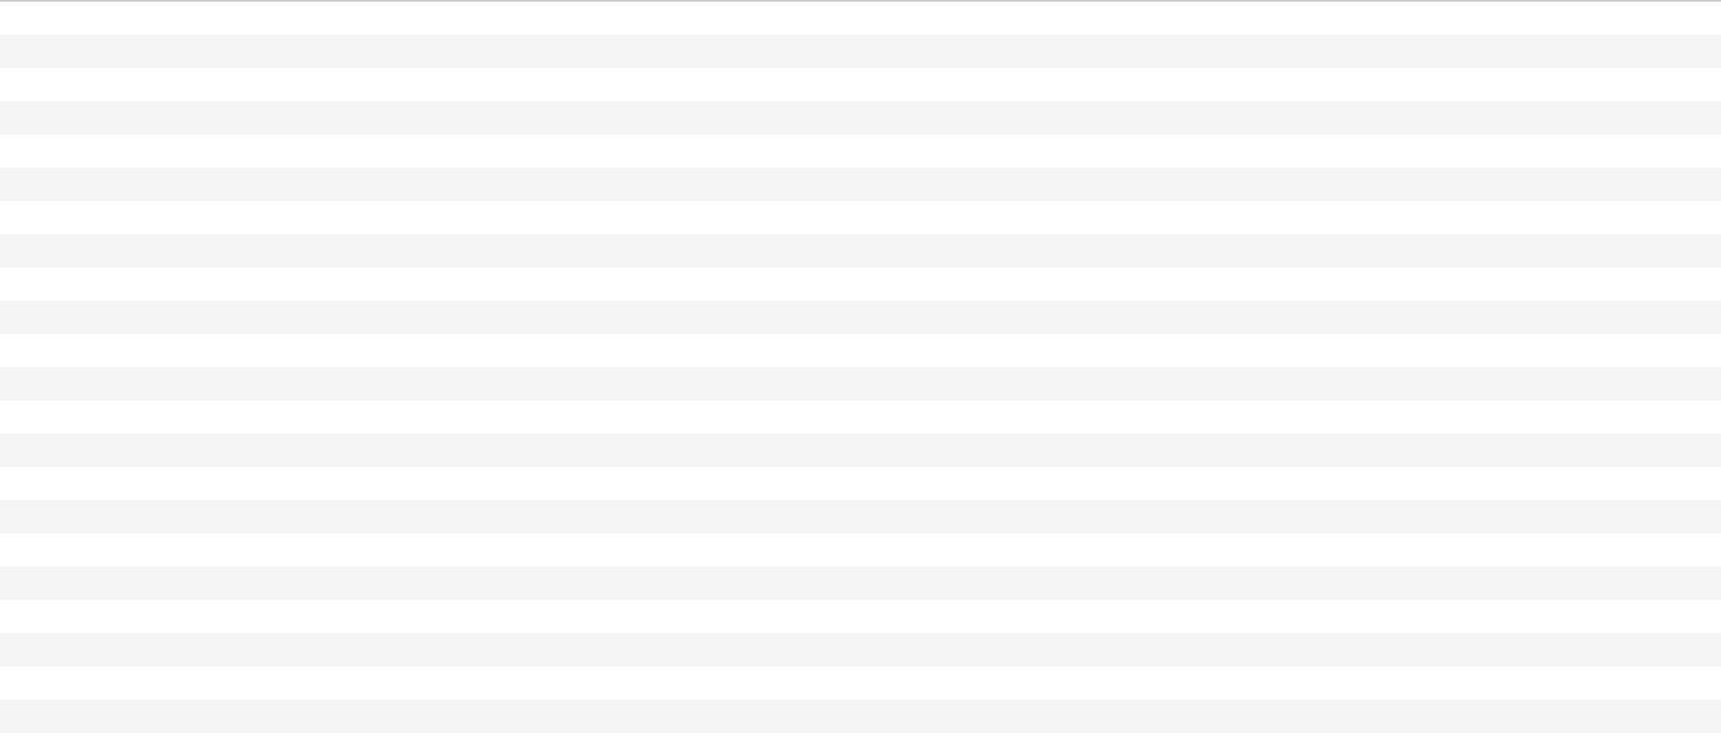
echo good_news.txt
Notes:
this is a OPPO phone. be like oppo.

Slide 33
THANK YOU!
github: huuck twitter: @hookgab

